Slide 1
Machine Learning – Neural Networks David Fenyő
Contact: David@FenyoLab.org

Slide 2
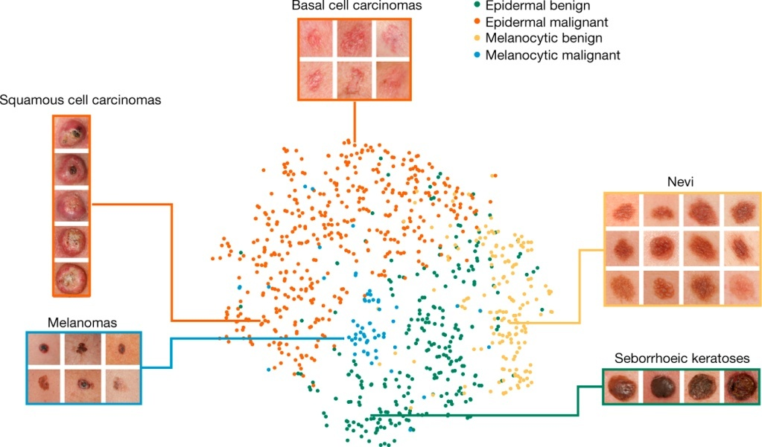
Example: Skin Cancer Diagnosis
2
Esteva et al., “Dermatologist-level classification of skin cancer with
deep neural networks”, Nature. 2017

Slide 3
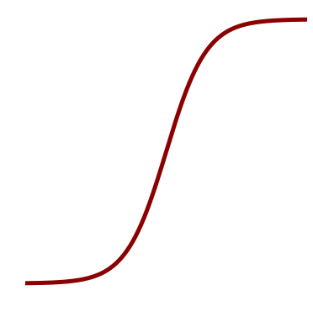
Logistic Regression
x₁
w₁
$$f(\sum_{i}{{w_{i}x}_{i}}+b)$$
3
w₂
x₂
.
.
.
$$1$$
x_{n}
w_{n}
$$f(z)=\frac{1}{1+e^{−z}}$$
$$0$$

Slide 4
Architecture
x₁
w₁
$$f(\sum_{i}{{w_{i}x}_{i}}+b)$$
4
w₂
x₂
.
.
.
x_{n}
w_{n}
Input
Output
Hidden

Slide 5
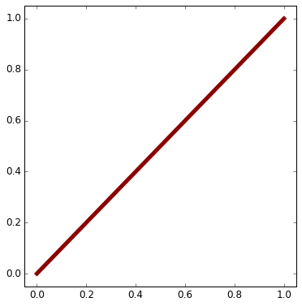
Activation Functions
$$1$$
5
$$σ(z)=\frac{1}{1+e^{−z}}$$
Sigmoid:
Hyperbolic
tangent:
ReLu:
$$0$$
$$1$$
$$tanh\left(z\right)=\frac{e^{z}−e^{−z}}{e^{z}+e^{−z}}=2σ\left(2z\right)−1$$
$$−1$$
z
$$ReLU(z)=max⁡(0,z)$$
$$0$$

Slide 6
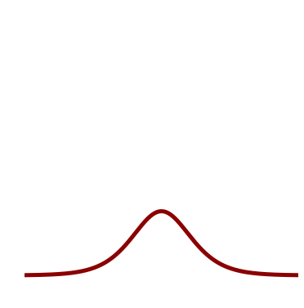
Activation Function Derivatives
$$1$$
$$σ(z)=\frac{1}{1+e^{−z}}$$
$$\frac{dσ(z)}{dz}=σ(z)(1−σ(z))$$
6
Sigmoid:
ReLu:
$$0$$
$$1$$
z
$$ReLU(z)=max⁡(0,z)$$
$$0$$
$$0$$
$$\frac{dReLU(z)}{dz}=\left(\begin{matrix}0 if z<0 \\ 1 if z>0\end{matrix}\right)$$

Slide 7
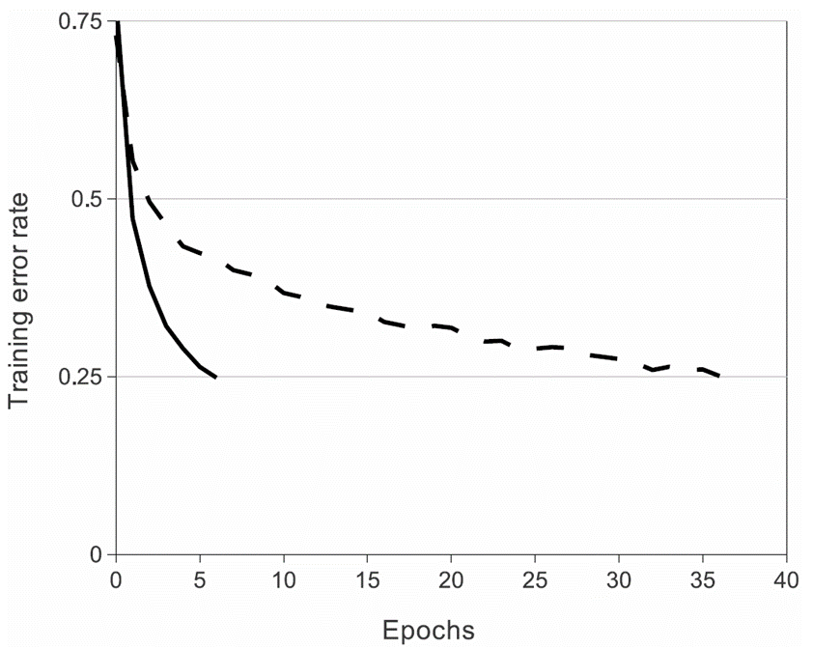
Faster Learning with ReLU
7
A four-layer convolutional neural network with ReLUs (solid line) reaches a 25% training error rate on CIFAR-10 six times faster than an equivalent network with tanh neurons (dashed line).
Krizhevsky A, Sutskever I, Hinton GE. Imagenet classification with deep convolutional neural networks. In Advances in Neural Information Processing Systems 2012 (pp. 1097-1105).

Slide 8
Activation Functions for Output Layer
8
$$σ(z)=\frac{1}{1+e^{−z}}$$
Binary classification: Sigmoid:
Multi-class classification: Softmax
$$=\frac{e^{z_{k}}}{\sum_{j}{e^{z_{j}}}}$$

Slide 9
Backpropagation
$$\frac{∂a}{∂w_{i}}$$
x₁
w₁
$$a=f\left(z\right)=$$
$$f(\sum_{i}{{w_{i}x}_{i}}+b)$$
9
$$\frac{∂L}{∂w_{i}}$$
w₂
$$\frac{∂L}{∂a}$$
x₂
f(z)
.
.
.
x_{n}
w_{n}
Chain Rule
$$\frac{∂L}{∂w_{i}}=\frac{∂a}{∂w_{i}}\frac{∂L}{∂a}$$

Slide 10
Backpropagation
$$\frac{∂L}{∂y}$$
+
10
$$a=y+c$$
$$\frac{∂L}{∂a}$$
y
$$\frac{∂a}{∂y}=\frac{∂(y+c)}{∂y}=\frac{∂y}{∂y}+\frac{∂c}{∂y}=1$$
$$\frac{∂L}{∂y}=\frac{∂a}{∂y}\frac{∂L}{∂a}=\frac{∂L}{∂a}$$

Slide 11
Backpropagation
$$\frac{∂L}{∂y_{1}}$$
y₁
+
11
$$a=y_{1}+y_{2}$$
$$\frac{∂L}{∂a}$$
y₂
$$\frac{∂L}{∂y_{2}}$$
$$\frac{∂a}{∂y_{i}}=1$$
$$\frac{∂L}{∂y_{i}}=\frac{∂L}{∂a}$$

Slide 12
Backpropagation
$$\frac{∂L}{∂y}$$
*
12
$$a=cy$$
$$\frac{∂L}{∂a}$$
y
$$\frac{∂a}{∂y}=c$$
$$\frac{∂L}{∂y}=c\frac{∂L}{∂a}$$

Slide 13
Backpropagation
$$\frac{∂L}{∂w_{1}}=\frac{∂a_{11}}{∂w_{1}}\frac{∂a_{21}}{∂a_{11}}\frac{∂L}{∂a_{21}}$$
$$=x_{1}(1)\frac{∂L}{∂a_{21}}$$
x₁
*
$$\frac{∂a_{21}}{∂a_{11}}=1$$
13
w₁
$$\frac{∂a_{11}}{∂w_{1}}=x_{1}$$
+
$$a_{11}=w_{1}x_{1}$$
$$a_{21}=a_{11}+a_{12}$$
$$\frac{∂L}{∂a_{21}}$$
$$a_{12}=w_{2}x_{2}$$
x₂
*
$$\frac{∂a_{21}}{∂a_{12}}=1$$
w₂
$$\frac{∂a_{12}}{∂w_{2}}=x_{2}$$
$$\frac{∂L}{∂w_{2}}=\frac{∂a_{12}}{∂w_{2}}\frac{∂a_{21}}{∂a_{12}}\frac{∂L}{∂a_{21}}$$
$$=x_{2}(1)\frac{∂L}{∂a_{21}}$$

Slide 14
Backpropagation
x₁ =3
*
14
1
w₁ =1
3
3
+
$$\frac{∂L}{∂a}$$
-5
x₂ =-4
-8
*
1
w₂ =2
-4

Slide 15
Backpropagation
$$\frac{∂L}{∂y_{1}}$$
y₁
$$a=$$
$$max(y_{1},y_{2})$$
max
15
$$\frac{∂L}{∂a}$$
y₂
$$\frac{∂L}{∂y_{2}}$$
$$\frac{∂a}{∂y_{1}}=1,\frac{∂a}{∂y_{2}}=0,if y_{1}>y_{2}$$
$$\frac{∂a}{∂y_{1}}=0,\frac{∂a}{∂y_{2}}=1,if y_{1}<y_{2}$$

Slide 16
Backpropagation
$$\frac{∂L}{∂y}$$
16
$$a=1/y$$
$$\frac{∂L}{∂a}$$
y
$$1/y$$
$$\frac{∂a}{∂y}=−\frac{1}{y^{2}}$$
$$\frac{∂L}{∂y}=−\frac{1}{y^{2}}\frac{∂L}{∂a}$$

Slide 17
Backpropagation
$$\frac{∂L}{∂y}$$
exp
17
$$a=e^{y}$$
$$\frac{∂L}{∂a}$$
y
$$\frac{∂a}{∂y}=e^{y}$$
$$\frac{∂L}{∂y}=e^{y}\frac{∂L}{∂a}$$

Slide 18
Backpropagation
$$\frac{∂L}{∂w_{1}}=\frac{∂a_{11}}{∂w_{1}}\frac{∂a_{21}}{∂a_{11}}\frac{∂a_{31}}{∂a_{21}}\frac{∂a_{41}}{∂a_{31}}\frac{∂a_{51}}{∂a_{41}}\frac{∂a_{61}}{∂a_{51}}\frac{∂L}{∂a_{61}}$$
$$=x_{1}(1)(−1)e^{a_{31}}(1)(−\frac{1}{{a_{51}}^{2}})\frac{∂L}{∂a_{61}}$$
$$\frac{∂a_{21}}{∂a_{11}}=1$$
x₁
$$\frac{∂a_{41}}{∂a_{31}}$$
$$=$$
$$e^{a_{31}}$$
$$\frac{∂a_{51}}{∂a_{41}}$$
$$=$$
$$1$$
$$\frac{∂a_{61}}{∂a_{51}}$$
$$=$$
$$−\frac{1}{{a_{51}}^{2}}$$
18
*
$$a_{11}$$
$$=$$
$$w_{1}x_{1}$$
$$\frac{∂a_{31}}{∂a_{21}}$$
$$=$$
$$−1$$
w₁
$$\frac{∂a_{11}}{∂w_{1}}=x_{1}$$
+
-
exp
1+
1/x
$$\frac{∂L}{∂a_{61}}$$
x₂
$$a_{21}$$
$$=$$
$$a_{11}+a_{12}$$
$$a_{31}$$
$$=$$
$$−a_{21}$$
$$a_{41}$$
$$=$$
$$e^{a_{31}}$$
$$a_{51}$$
$$=$$
1$+a_{41}$
$$a_{61}$$
$$=$$
$$\frac{1}{a_{51}}$$
*
$$a_{12}$$
$$=$$
$$w_{2}x_{2}$$
w₂
$$\frac{∂a_{12}}{∂w_{2}}\text{=}x_{2}$$
$$\frac{∂a_{21}}{∂a_{12}}=1$$
$$\frac{∂L}{∂w_{2}}=\frac{∂a_{12}}{∂w_{2}}\frac{∂a_{21}}{∂a_{11}}\frac{∂a_{31}}{∂a_{21}}\frac{∂a_{41}}{∂a_{31}}\frac{∂a_{51}}{∂a_{41}}\frac{∂a_{61}}{∂a_{51}}\frac{∂L}{∂a_{61}}$$
$$=x_{2}(1)(−1)e^{a_{31}}(1)(−\frac{1}{{a_{51}}^{2}})\frac{∂L}{∂a_{61}}$$

Slide 19
Backpropagation
x₁ =3
*
0.02
6.6E-3
6.6E-3
-6.6E-3
-4.5E-5
-4.5E-5
$$\frac{∂L}{∂a}$$
w₁ =1
3
+
-
exp
1+
1/x
x₂ =-4
6.6E-3
-5
5
148.4
149.4
0.0067
*
-0.027
-8
w₂ =2

Slide 20
Backpropagation
x₁
20
*
w₁
+
-
exp
+
1/x
x₂
*
w₂
σ

Slide 21
Backpropagation
$$\frac{∂a_{21}}{∂a_{11}}=1$$
x₁
21
*
$$a_{11}$$
$$=$$
$$w_{1}x_{1}$$
$$\frac{∂a_{31}}{∂a_{21}}=σ(a_{21})(1−σ\left(a_{21}\right))$$
w₁
$$\frac{∂a_{11}}{∂w_{1}}=x_{1}$$
$$\frac{∂L}{∂a}$$
+
σ
x₂
$$a_{21}=a_{11}+a_{12}$$
$$a_{31}=σ(a_{21})$$
*
$$a_{12}$$
$$=$$
$$w_{2}x_{2}$$
w₂
$$\frac{∂a_{12}}{∂w_{2}}\text{=}x_{2}$$
$$\frac{∂a_{21}}{∂a_{12}}=1$$

Slide 22
Backpropagation
x₁ =3
22
*
0.02
6.6E-3
6.6E-3
$$\frac{∂L}{∂a}$$
w₁ =1
3
+
σ
x₂ =-4
6.6E-3
-5
0.0067
*
-0.027
-8
w₂ =2

Slide 23
Backpropagation
23
$${\left(\frac{∂L}{∂a}\right)}_{1}$$
$$+$$
$${\left(\frac{∂L}{∂a}\right)}_{2}$$

Slide 24
Backpropagation
Layer 1
Layer 2
Layer 3
$$w_{74}^{2}$$
$$b_{7}^{2}$$
$$a_{7}^{2}$$
$$a_{j}^{l}=f\left(\sum_{k}{w_{jk}^{l}a_{k}^{l−1}+b_{j}^{l}}\right)=f(z_{j}^{l})$$
$$a^{l}=f\left(w^{l}a^{l−1}+b^{l}\right)=f(z^{l})$$
$$δ_{j}^{l}=\frac{∂L}{∂z_{j}^{l}}$$
Error:
$$δ^{l}=∇_{z}L$$

Slide 25
Backpropagation
Error for output layer (l=N):
$$δ_{j}^{N}=\frac{∂L}{∂z_{j}^{N}}$$
$$⇓$$
Chain Rule
$$δ_{j}^{N}=\sum_{k}{\frac{∂L}{∂a_{k}^{N}}\frac{∂a_{k}^{N}}{∂z_{j}^{N}}}$$
$$δ^{N}=∇_{a}L⨀f′(z^{N})$$
$$⇓$$
$$\frac{∂a_{k}^{N}}{∂z_{j}^{N}}=0 if k≠j$$
$⨀$- Element-wise multiplication of vectors
$$δ_{j}^{N}=\frac{∂L}{∂a_{j}^{N}}\frac{∂a_{j}^{N}}{∂z_{j}^{N}}$$
$$⇓$$
$$a_{j}^{N}=f(z_{j}^{N})$$
$$δ_{j}^{N}=\frac{∂L}{∂a_{j}^{N}}\frac{∂f(z_{j}^{N})}{∂z_{j}^{N}}=\frac{∂L}{∂a_{j}^{N}}f′(z_{j}^{N})$$

Slide 26
Backpropagation
Error as a function of the error in the next layer:
$$δ_{j}^{l}=\frac{∂L}{∂z_{j}^{l}}$$
$$⇓$$
Chain Rule
$$δ_{j}^{l}=\frac{∂L}{∂z_{j}^{l}}=\sum_{k}{\frac{∂L}{∂z_{k}^{l+1}}\frac{∂z_{k}^{l+1}}{∂z_{j}^{l}}}$$
$$⇓$$
$$δ_{k}^{l+1}=\frac{∂L}{∂z_{k}^{l+1}}$$
$$δ^{l}=({(w^{l+1})}^{T}δ^{l+1})⨀f′(z^{l})$$
$$δ_{j}^{l}=\sum_{k}{δ_{k}^{l+1}\frac{∂z_{k}^{l+1}}{∂z_{j}^{l}}}$$
$$z_{k}^{l+1}=\sum_{i}{w_{ki}^{l+1}a_{i}^{l}+b_{k}^{l+1}}=$$
$$\sum_{i}{w_{ki}^{l+1}f(z_{i}^{l})+b_{k}^{l+1}}$$
$$⇓$$
$$δ_{j}^{l}=\sum_{k}{δ_{k}^{l+1}w_{kj}^{l+1}f′(z_{j}^{l})}$$

Slide 27
Backpropagation
Gradient with respect to bias
$$\frac{∂L}{∂b_{j}^{l}}$$
$$⇓$$
Chain Rule
$$\frac{∂L}{∂b_{j}^{l}}=\sum_{k}{\frac{∂L}{∂z_{k}^{l}}\frac{∂z_{k}^{l}}{∂b_{j}^{l}}}$$
$$∇_{b}L=δ^{l}$$
$$⇓$$
$$δ_{k}^{l}=\frac{∂L}{∂z_{k}^{l}}$$
$$\frac{∂L}{∂b_{j}^{l}}=\sum_{k}{δ_{k}^{l}\frac{∂z_{k}^{l}}{∂b_{j}^{l}}}$$
$$⇓$$
$$z_{k}^{l}=\sum_{i}{w_{ki}^{l}a_{i}^{l−1}+b_{k}^{l}}$$
$$\frac{∂L}{∂b_{j}^{l}}=δ_{j}^{l}$$

Slide 28
Backpropagation
Gradient with respect to weights
$$\frac{∂L}{∂w_{jk}^{l}}$$
$$⇓$$
Chain Rule
$$\frac{∂L}{∂w_{jk}^{l}}=\sum_{i}{\frac{∂L}{∂z_{i}^{l}}\frac{∂z_{i}^{l}}{∂w_{jk}^{l}}}$$
$$∇_{w}L=δ^{l}{(a^{l−1})}^{T}$$
$$⇓$$
$$δ_{i}^{l}=\frac{∂L}{∂z_{i}^{l}}$$
$$\frac{∂L}{∂w_{jk}^{l}}=\sum_{i}{δ_{i}^{l}\frac{∂z_{i}^{l}}{∂w_{jk}^{l}}}$$
$$⇓$$
$$z_{i}^{l}=\sum_{m}{w_{im}^{l}a_{m}^{l−1}+b_{i}^{l}}$$
$$\frac{∂L}{∂w_{jk}^{l}}=a_{k}^{l−1}δ_{j}^{l}$$

Slide 29
Backpropagation
For each training example x in mini-batch of size m:
Forward Pass:
Output Error:
Error Backpropagation:
Gradient Descent:
$$a^{x,l}=f(z^{x,l}) =f(w^{l}a^{x,l−1}+b^{l})$$
$$δ^{x,N}=∇_{a}L⨀f′(z^{x,N})$$
$$δ^{x,l}=({(w^{l+1})}^{T}δ^{x,l+1})⨀f′(z^{x,l})$$
$$b^{l}→b^{l}−\frac{η}{m}\sum_{x}{δ^{x,l}}$$
$$w^{l}→w^{l}−\frac{η}{m}\sum_{x}{δ^{x,l}}{(a^{x,l−1})}^{T}$$

Slide 30
$$1$$
Vanishing Gradient
σ
σ
σ
σ
$$\frac{∂L}{∂z}$$
$$0$$
30
$$δ^{l}=δ^{l+1}w^{l+1}σ^{′}\left(z^{l}\right)$$
$$⇓$$
$$δ^{N}=\frac{∂L}{∂a^{N}}σ′(z^{N})$$
$$δ^{l}=\frac{∂L}{∂a^{N}}σ′(z^{N})\prod_{j=l}^{j=N−1}{w^{j+1}σ^{′}\left(z^{j}\right)}$$
$$⇓$$
$$\frac{δ^{l}}{δ^{l+k}}=\prod_{j=l}^{j=l+k}{w^{j+1}σ^{′}\left(z^{j}\right)}$$
$$⇓$$
$$w^{j+1}<1$$
$$σ^{′}\left(z^{j}\right)≤σ^{′}\left(0\right)=\frac{1}{4}$$
$$\frac{δ^{l}}{δ^{l+k}}<\frac{1}{4^{k}}$$

Slide 31
Dying ReLu’s
$$1$$
z
$$ReLU(t)=max⁡(0,z)$$
$$0$$
$$0$$
$$\frac{dReLU(z)}{dt}=\left(\begin{matrix}0 if z<0 \\ 1 if z>0\end{matrix}\right)$$
$$\left.\begin{matrix}\frac{∂a}{∂w}=x_{1} \\ \frac{∂a}{∂b}=1\end{matrix}\right\} if{wx}_{1}+b>0$$
ReLU
$$a=$$
$$max(0,{wx}_{1}+b)$$
x₁
$$\frac{∂L}{∂a}$$
$$\left.\begin{matrix}\frac{∂a}{∂w}=0 \\ \frac{∂a}{∂b}=0\end{matrix}\right\} if{wx}_{1}+b<0$$

Slide 32
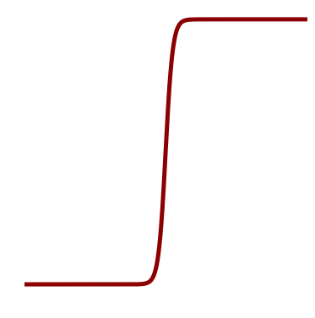
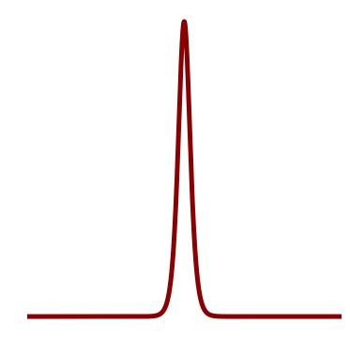
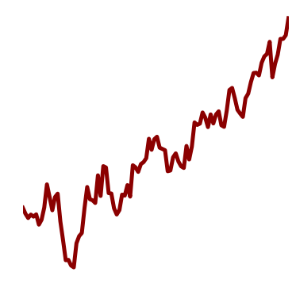
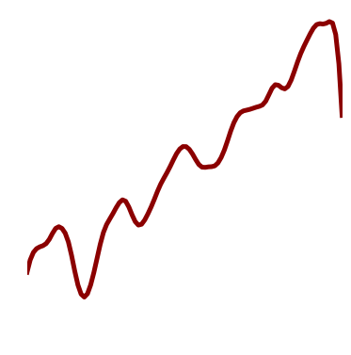
Universal Function Approximation
“…arbitrary decision regions can be arbitrarily well approximated by continuous feedforward neural networks with only a single internal, hidden layer and any continuous sigmoidal nonlinearity.”
Cybenko G. Approximation by superpositions of a sigmoidal function. Mathematics of Control, Signals, and Systems (MCSS). 1989 Dec 1;2(4):303-14.
32
Sigmoid
Subtraction of two sigmoid with small shift
A function
Approximations
of the function with sigmoids

Slide 33
Convolutional neural networks (CNNs)
Local receptive field
http://en.wikipedia.org/wiki/Convolution
Describes the response of a linear and time-invariant system to an input signal.
The inverse Fourier transform of the pointwise product in frequency space
Shared weights and biases
LeCun Y, Bottou L, Bengio Y, Haffner P. Gradient-based learning applied to document recognition. Proceedings of the IEEE. 1998 Nov;86(11):2278-324.

Slide 34
Convolutional neural networks (CNNs)
LeNet-5
LeCun Y, Bottou L, Bengio Y, Haffner P. Gradient-based learning applied to document recognition. Proceedings of the IEEE. 1998 Nov;86(11):2278-324.

Slide 35
Convolutional neural networks (CNNs)
AlexNet
Krizhevsky A, Sutskever I, Hinton GE. Imagenet classification with deep convolutional neural networks. In Advances in Neural Information Processing Systems 2012 (pp. 1097-1105).

Slide 36
Convolutional neural networks (CNNs)
VGG Net
Deep with small convolution filters

Slide 37
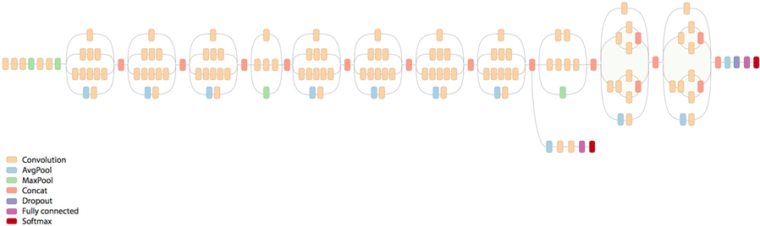
Convolutional neural networks (CNNs)
GoogLeNet
Inception modules (parallel layers with multi-scale processing) increases the
depth and width of the network while keeping the computational budget constant.
Szegedy C, Liu W, Jia Y, Sermanet P, Reed S, Anguelov D, Erhan D, Vanhoucke V, Rabinovich A. Going deeper with convolutions. In Proceedings of the IEEE Conference on Computer Vision and Pattern Recognition 2015 (pp. 1-9).

Slide 38
Convolutional neural networks (CNNs)
ResNet
Kaiming He, Xiangyu Zhang, Shaoqing Ren, Jian Sun, Deep Residual Learning for Image Recognition, arXiv:1512.03385 [cs.CV], 2015

Slide 39
Mini-Batch Gradient Descent
Mini-batch gradient descent: Uses a subset of the training set to calculate the gradient for each step.

Slide 40
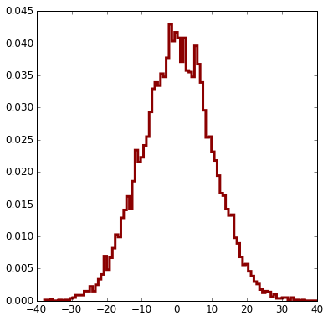
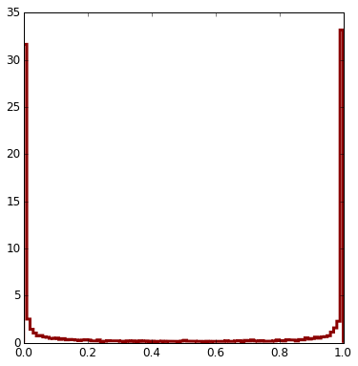
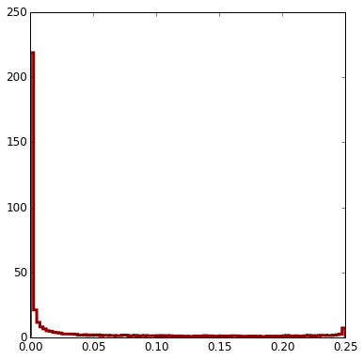
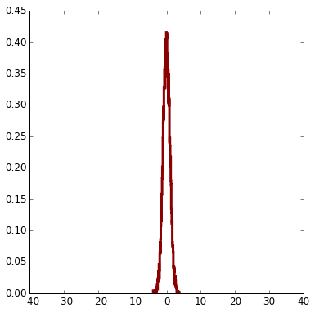
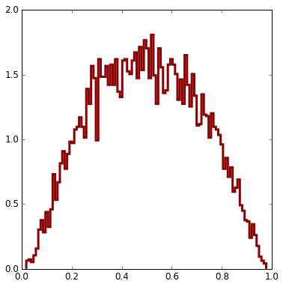
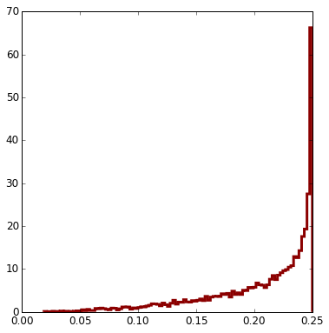
Initialization
w_{i} initialized to be normally distributed (μ=0, σ=1)
40
z=Σw_{i}x_{i}
σ(z)
σ'(z)
x_{i}, i=1..N, normally distributed (μ=0, σ=1), N=100
w_{i} initialized to be normally distributed (μ=0, σ=1/N)
z=Σw_{i}x_{i}
σ(z)
σ'(z)

Slide 41
Transfer Learning
If your data set is limited in size:
Use a pre-trained network and only remove the last fully connected layer and train a linear classifier using your data set.
Fine tune part of the network using backpropagation.
Example: “An image of a skin lesion (for example, melanoma) is sequentially warped into a probability distribution over clinical classes of skin disease using Google Inception v3 CNN architecture pretrained on the ImageNet dataset (1.28 million images over 1,000 generic object classes) and fine-tuned on our own dataset of 129,450 skin lesions comprising 2,032 different diseases.”
Esteva et al., “Dermatologist-level classification of skin cancer with deep neural networks”, Nature. 2017

Slide 42
Data Augmentation
42
Translations
Rotations
Reflections
Intensity and color of illumination
Deformation

Slide 43
Batch Normalization
43
For each mini-batch, B, normalize between each layer:
$${\hat{x}}_{i}=\frac{x_{i}−μ_{B}}{\sqrt{σ_{B}^{2}+ε}}$$
$$y_{i}=γ{\hat{x}}_{i}+β$$
Regularization and faster learning
Karpathy, Ioffe S, Szegedy C. Batch normalization: Accelerating deep network training by reducing internal covariate shift. arXiv preprint arXiv:1502.03167. 2015 Feb 11.

Slide 44
Regularization - Dropout
44

Slide 45
Recurrent convolutional neural networks (R-CNNs)
45
y
y_{t-1}
y_{t}
y_{t+1}
$$W_{hy}$$
h
$$W_{hh}$$
h_{t-1}
h_{t}
h_{t+1}
$$W_{xh}$$
x
x_{t-1}
x_{t}
x_{t+1}
$$h_{t}=\tanh\left(W_{hh}h_{t−1}+W_{xh}x_{t}\right)$$
$$y_{t}=W_{hy}h_{t}$$

Slide 46
Recurrent convolutional neural networks (R-CNNs)
46
CNN
Image captioning
Sentiment
Classification
Translation
Classification of each frame of a video
Andrej Karpathy, The Unreasonable Effectiveness of Recurrent Neural Networks, http://karpathy.github.io/2015/05/21/rnn-effectiveness/

Slide 47
Long Short-Term Memory (LSTM)
LSTM
RNN
y
Cell state update:
$$C_{t}=f_{t}⨀C_{t−1}+i_{t}⨀tanh⁡(W_{c}\left[h_{t−1},x_{t}\right]+b_{c})$$
$$W_{y}$$
$$h_{t}=o_{t}⨀tanh⁡⁡(C_{t})$$
h
$$W_{h}$$
x
Forget gate: $f_{t}=σ⁡(W_{f}\left[h_{t−1},x_{t}\right]+b_{f})$
Input gate: $i_{t}=σ⁡(W_{i}\left[h_{t−1},x_{t}\right]+b_{i})$
$$h_{t}=tanh⁡(W_{h}[h_{t−1},x_{t}])$$
$$y_{t}=W_{y}h_{t}$$
Output gate: $o_{t}=σ⁡⁡(W_{o}\left[h_{t−1},x_{t}\right]+b_{o})$
Hochreiter S, Schmidhuber J. Long short-term memory. Neural computation. 1997 Nov 15;9(8):1735-80.

Slide 48
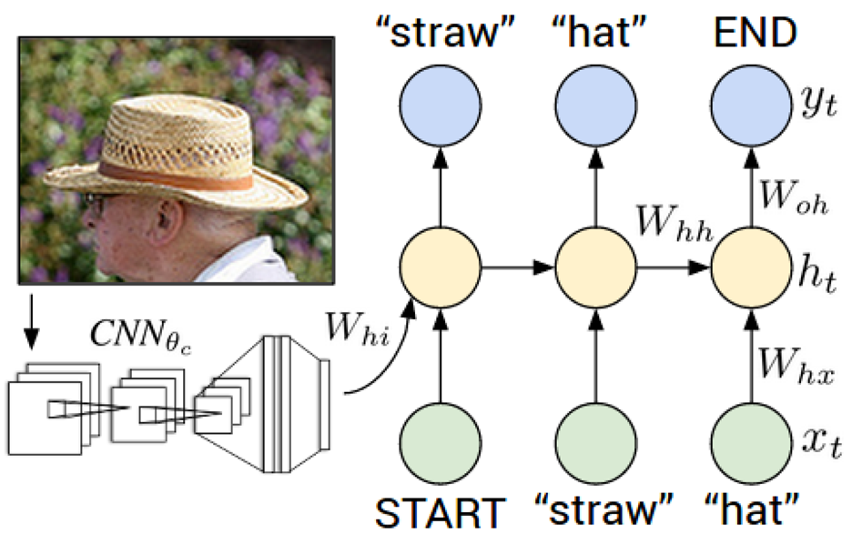
Image Captioning – Combining CNNs and RNNs
48
Karpathy, Andrej & Fei-Fei, Li, "Deep visual-semantic alignments for generating image descriptions", Proceedings of the IEEE Conference on Computer Vision and Pattern Recognition (2015) 3128-3137

Slide 49
Autoencoders – Unsupervised Learning
Autoencoders learn a lower dimensionality representation where output ≈ input
49
Lower
Dimensional
Representation
Input
Output

Slide 50
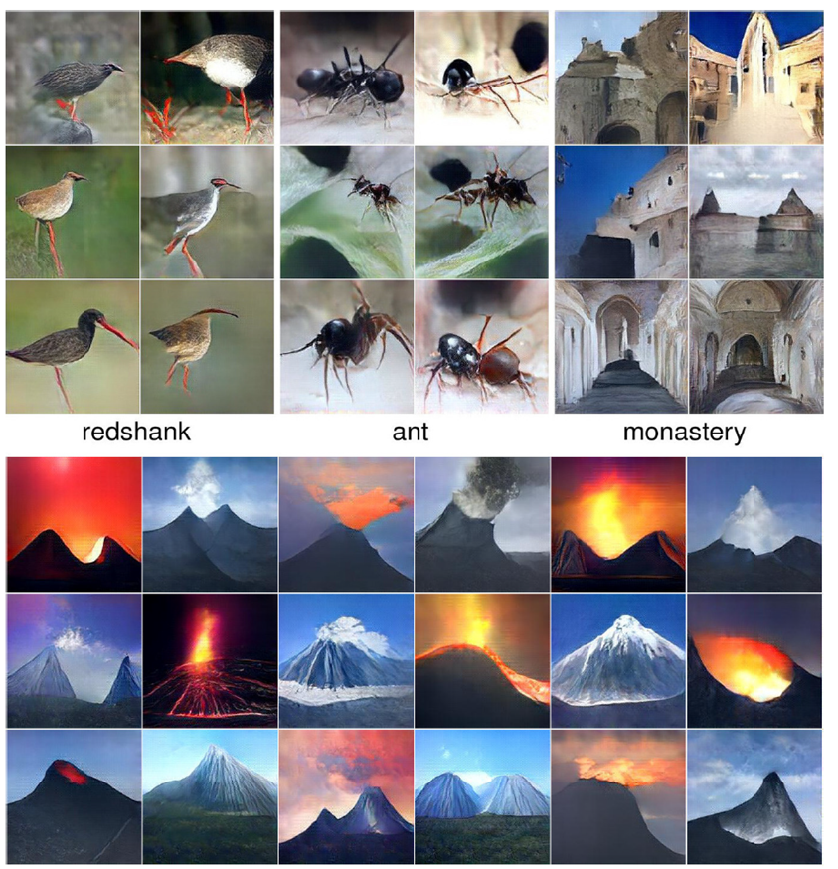
Generative Adversarial Networks
50
Nguyen et al., “Plug & Play Generative Networks: Conditional Iterative Generation of Images in Latent Space”, https://arxiv.org/abs/1612.00005.

Slide 51
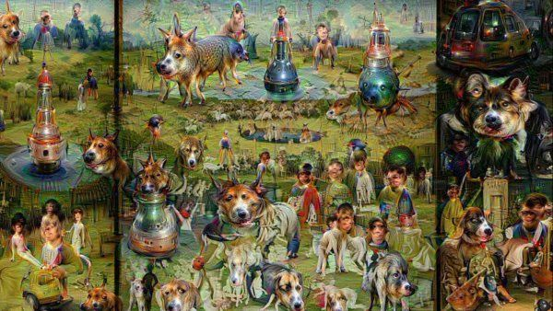
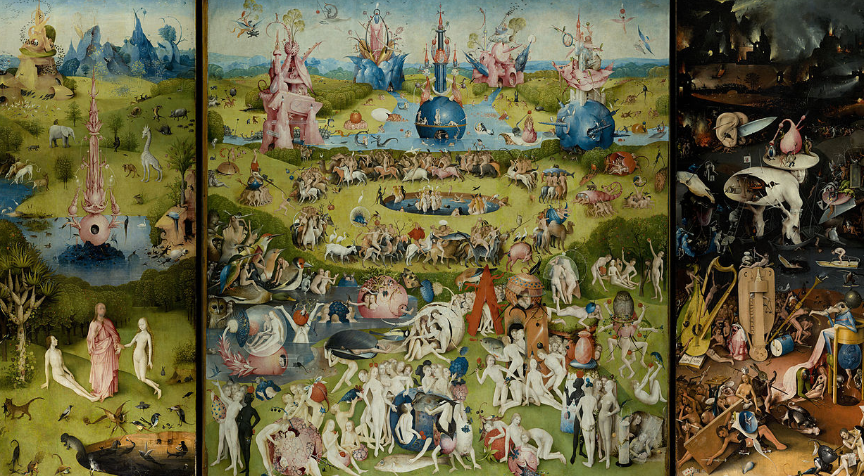
Deep Dream
51
Google DeepDream:
The Garden of Earthly Delights
Hieronymus Bosch:
The Garden of Earthly Delights

Slide 52
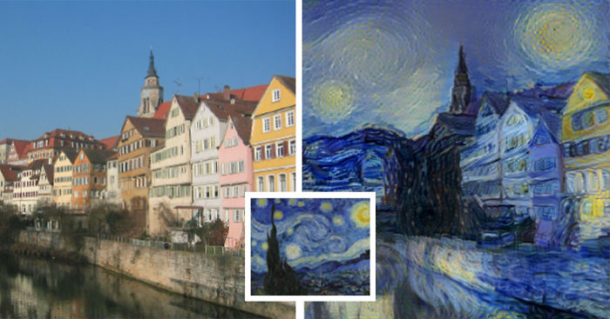
Artistic Style
52
LA. Gatys, A.S. Ecker, M. Bethge, “A Neural Algorithm of Artistic Style”, https://arxiv.org/pdf/1508.06576v1.pdf

Slide 53
Adversarial Fooling Examples
Original correctly
classified image
Classified
as ostrich
Perturbation
53
Szegedy et al., “Intriguing properties of neural networks”, https://arxiv.org/abs/1312.6199

Slide 54
Adversarial Fooling Examples
54
Wieland Brendel, https://medium.com/bethgelab/ai-still-fails-on-robust-handwritten-digit-recognition-and-how-to-fix-it-a432d84ede18

